Slide 1
Risk-Return judgments & the affect heuristic
Janine Hoffart,
Jana Jarecki,
Jörg Rieskamp

Slide 2
Riskier investment options offer higher returns.
SMI 20
Risk
(=Variance)
$ $$ $$$
Return

Slide 3
People assume that risks and returns are negatively correlated.
Risk-return tradeoff
Objective
Risk-return tradeoff
Subjective
≠
Risk
(=Variance)
Risk
(=Variance)
$ $$ $$$
Return
$ $$ $$$
Return
e.g., Kempf, Merkle & Niessen-Ruenzi (2014)

Slide 4
Affect heuristic as explanation for biased risk-return judgments.
Objective ≠ Subjective
Risk
Risk
Return
Return
:)
Affect
:(
Low risk
High return
High risk
Low return
e.g.,
Ganzach (2000)
Shefrin (2001)
Kempf, Merkle & Niessen-Ruenzi (2014)

Slide 5
Risk assessment as confound?
Typical questions:
How RISKY is it to invest in Index X.
Far below average Far above average
e.g.,
Kempf, Merkle & Niessen-Ruenzi (2014)

Slide 6
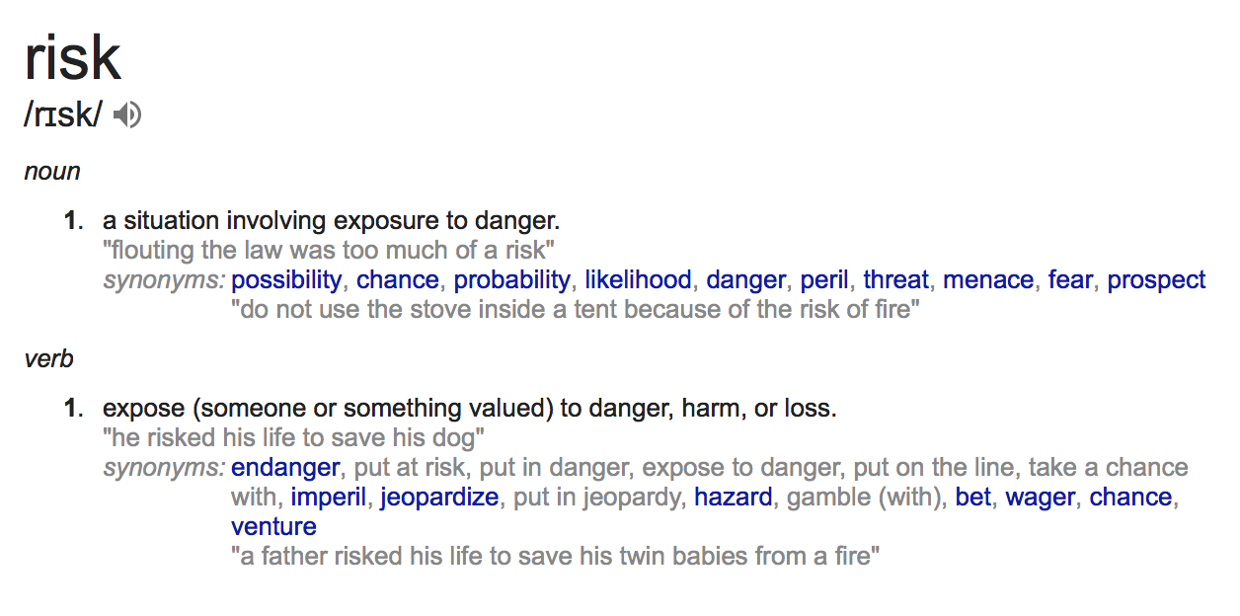
Does risk mean variance?
Objective
People relate to loss potential when they judge riskiness (Duxbury & Summers, 2004; Sachse, Jungermann & Belting, 2012)
Subjective risk perception varies between individuals (Mohr, Biele & Krugel, 2010)

Slide 7
Study overview.
Objective
Study 1:
How should we assess “risk” when we are interested in measuring risk-as-variance?
Study 2
Replication of the affect heuristic.

Slide 8
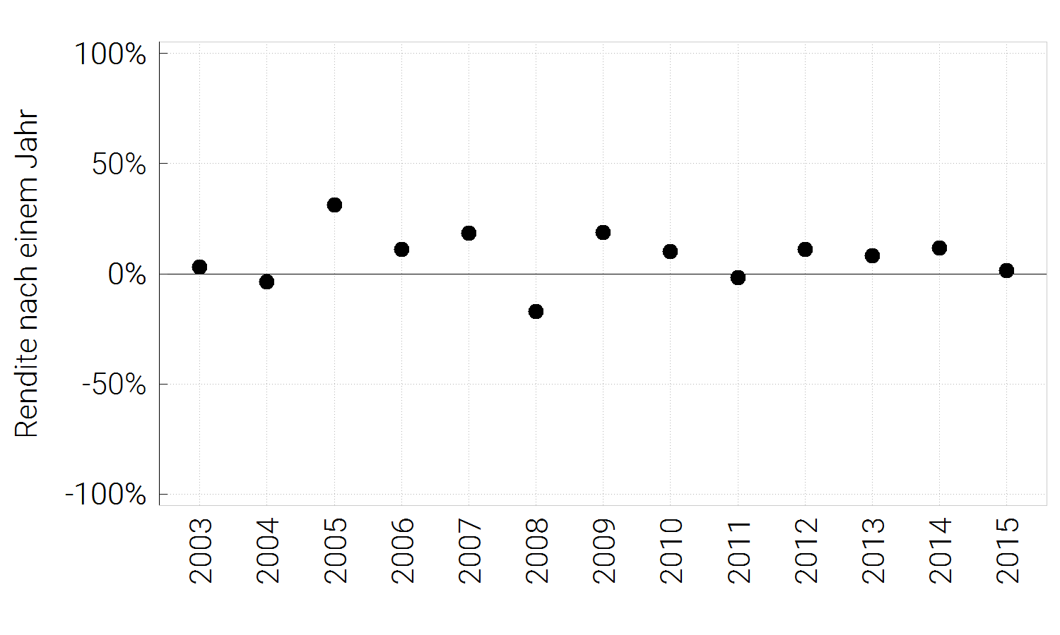
Experiment
People judged 19 return courses :
Return after 1 year in %
Risk
Predictability
Variability
Fluctuation
Variance measures

Slide 9
Experiment
Online study (Clickworker)
100 German speaking participants (7 excluded)
Reimbursed for participation (4.50 Euros)

Slide 10
Results
Study 1

Slide 11
Ask for fluctuation if you want to measure variance.
Notes:
Ordinal regression

Slide 12
Ask for fluctuation if you want to measure variance.
 | Scale
 | Risk | Predictability | Variability | Fluctuation
Variance_{Objective} | 12.92 | -17.43 | 25.89 | 28.56
AIC | 6293 | 6049 | 5450 | 5264
Notes:
Ordinal regression

Slide 13
Interim summary.
Best way to asses variance:
Ask for fluctuation!

Slide 14
Study 2
Replication of the affect heuristic

Slide 15
Experimental Design
“Risk” and return judgments for stock indices:
20 indices that represent countries/regions of most traded currencies
OMX

Slide 16
Objective risk return correlation

Slide 17
Experimental Design
“Risk” and return judgments for stock indices:
20 indices that represent countries/regions of most traded currencies
Between subjects manipulation of “risk” question:
Fluctuation
Risk

Slide 18
Experimental Design
“Risk” and return judgments for stock indices:
20 indices that represent countries/regions of most traded currencies
Between subjects manipulation of “risk” question:
Fluctuation
Risk
Between subjects: Graph vs. no graph

Slide 19
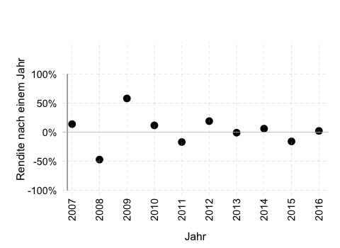
Half of the people saw graphs.
Index from the USA
(Dow Jones Industrial Average Index)
Index from the USA
(Dow Jones Industrial Average Index)
vs.
Return after 1 year in %

Slide 20
Experimental Design
“Risk” and return judgments for stock indices:
20 indices that represent countries/regions of most traded currencies
Between subjects manipulation of “risk” question:
Fluctuation
Risk
Between subjects: Graph vs. no graph
Affect judgments for countries/regions
Semantic differential scale: 4 dimensions
Good x x x x x Bad
Interesting x x x x x Boring
Active x x x x x Passive
Strong x x x x x Weak

Slide 21
Experiment
Online study (Clickworker)
238 German speaking participants
Reimbursed for participation (4.50 Euros)

Slide 22
Results: Replication of Study 1

Slide 23
Results: Subjective Risk-Return correlations
*
*

Slide 24
Results: Subjective Risk-Return correlations
*

Slide 25
Results: Subjective Risk-Return correlations
*
*

Slide 26
Affect as explanation for the negative risk-return correlations under uncertainty.
Fluctuation Judgments

Slide 27
Summary
Affect moderates risk and return judgments under uncertainty – irrespective of question!
Implications for information search!?

Slide 28
Spoiler
I only presented some data of our studies.
There is much more!
If you are interested in learning more about the relationship between risk & loss perception or the role of financial literacy in risk-return judgments: Come and find me during the conference.
I am happy to share and discuss more results.
Thank you for your attention

Slide 29
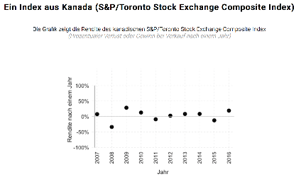
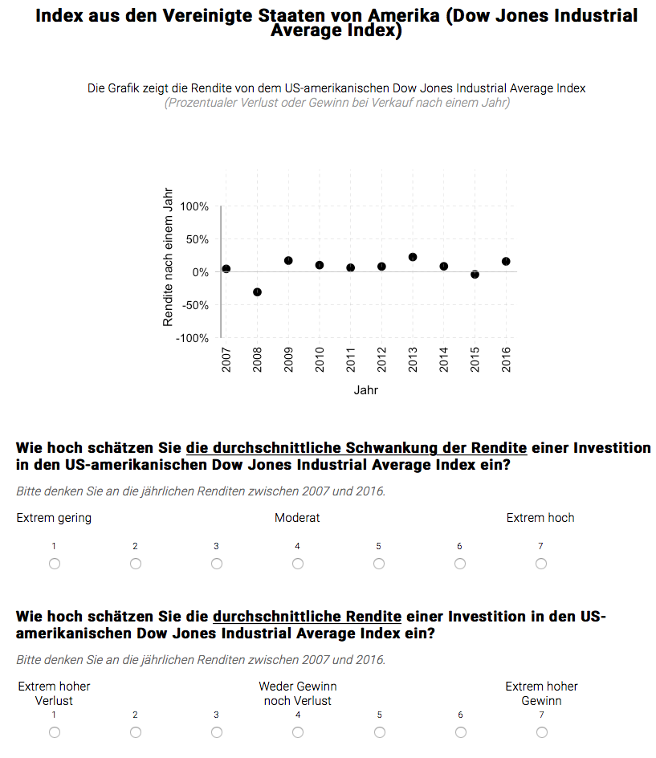
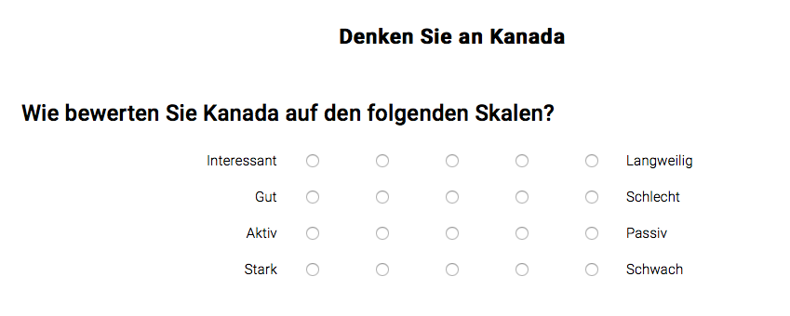
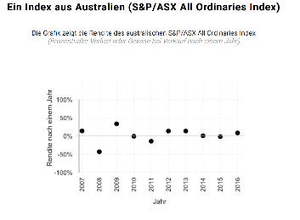
Example
Familiarization
Block
„Risk“-Return
Block
Affect
Block
One Index from Canada (S&P/Toronto
Stock Exchange Composite Index)
Index from the USA (Dow Jones Industrial Average Index)
The Figure shows the returns of the US-american Dow Jones Industrial Average Index
(Gain or Loss for selling the stock after one year in %)
Think about Canada
How do you judge Canada on the following scales?
Return after 1 Year
Interesting
Good
Active
Strong
Boring
Bad
Passive
Weak
year
1
-
20
1
-
20
How high is the average fluctuation of the returns of an investment in the US-american Dow Jones Industrial Average Index
Please think about the yearly returns between 2007 and 2016 when you make your judgment.
Extremely low Moderate Extremely high
One Index from Australia (S&P/ASX All Ordinaries Index)
How high is the average return of an investment in the US-american Dow Jones Industrial Average Index
Please think about the yearly returns between 2007 and 2016 when you make your judgment.
Extremely large loss No gain/loss Extremely large gain
Think about Indonesia
How do you judge Indonesia on the following scales?
Return after 1 Year
Interesting
Good
Active
Strong
Boring
Bad
Passive
Weak
year

Slide 30
Return - Affect

Slide 31
Risk - Affect

Slide 32
What does it mean for you that a stock has “large risk“?
Uncertainty / Predictability
Uncertainty
/
Predictability
Gain
Gain: Probability
Variance / Fluctuation
Gain: Magnitude
Variance
/
Fluctuation
Gain: P & M
Gain: Undefined
Loss
Loss Probability
Other
inappropriate
Loss: Magnitude
Loss: Probability & Magnitude
Loss: Not defined

Slide 33
Loss_{Objective} explains risk_{subjective} but not fluctuation_{subjective}.
Semipartial correlation
Scale_{subjective} | Scale_{objective} | _{sr}
Risk | Variance | .21***
 | EV(loss) | .17***
Fluctuation | Variance | .46***
 | EV(loss) | .02_{n.s.}
(Proportion of variance of responses accounted for by Scale_{objective} after second Scale_{objective} has already been taken into account)

Slide 34
OMX

